Slide 1
Officer Summary Record (OSR)
Records Maintenance
** With the exception of awards, your OSR is fed by your ODC, ensuring
an updated and accurate ODC will result in a similar OSR! **
Updated Jan 2022

Slide 2
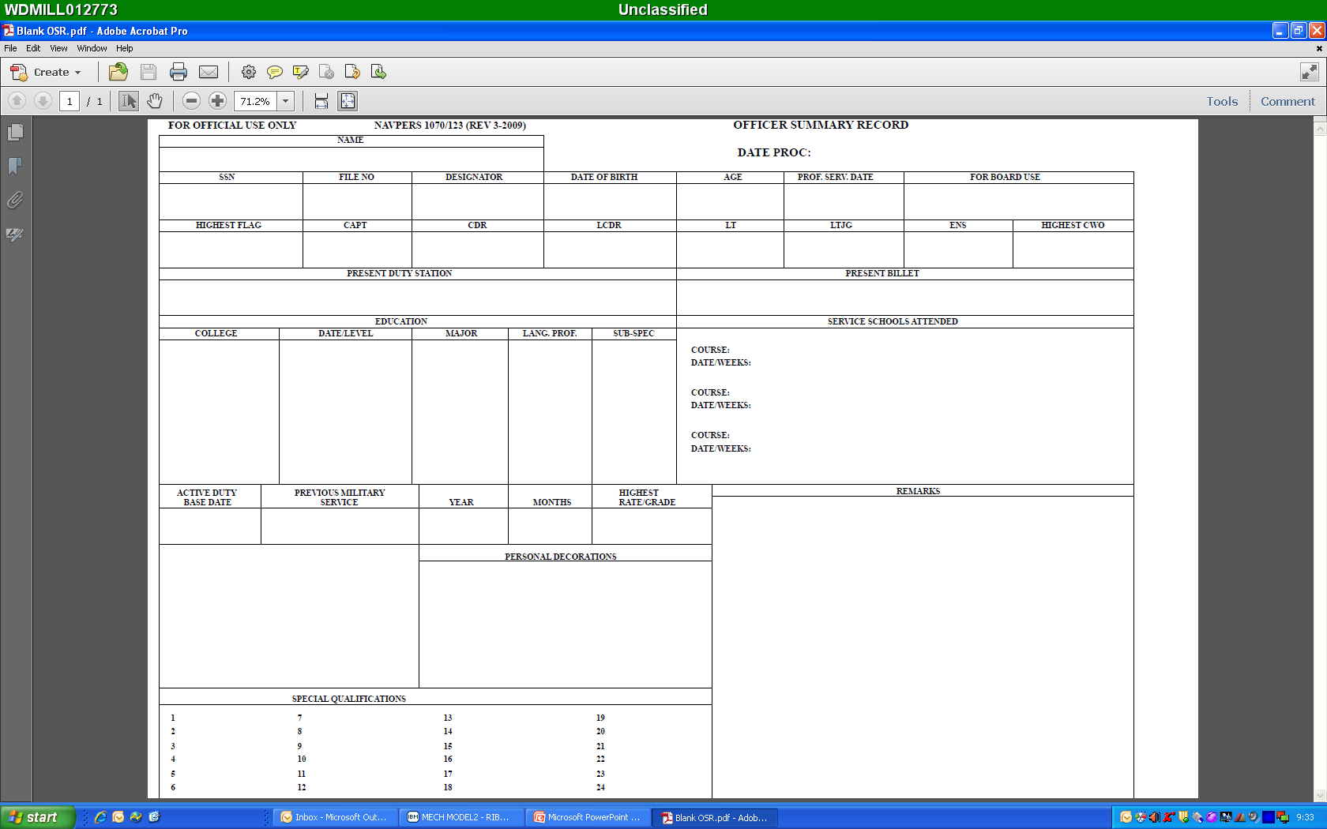
Social Security #
Full Name
Auto-fill
Auto-fill
Auto-fill
Auto-fill
Auto-fill
Auto-fill
Auto-fill
Auto-fill
Auto-fill
Auto-fill from Block 77 of ODC
Auto-fill from Block 82 of ODC
Auto-fill from Block 54 of ODC
Auto-fill from Block 58 of ODC
Auto-fill from Block 59 of ODC
Auto-fill from Blocks 66, 67, and 68 of ODC
Auto-fill from Block 52 of ODC (room for six total schools)
Auto-fill
Auto-fill
Auto-fill
Auto-fill
Auto-fill
Auto-fill from Navy Awards Website (NDAWS), see Note 1 on the following slide.
Auto-fill from Block 72, 83, and 91 of ODC (captures all AQD’s and NOBC’s)

Slide 3
“How To” Guide
Notes
Awards: The Personal Decorations block of your OSR is fed directly from what is on file at the Navy Awards Website, NDAWS (personal awards query). The Personal Decorations block will only capture individual awards, NAM or higher (no unit awards). If you are missing an award, please work through your respective NDAWS representative to have it added.
PERS-312 will not accept awards directly from the member and from commands where sailors serve. Members are to work directly with their supporting administrative offices to get valid awards entered into BOL NDAWS and the member’s OMPF.
The BOL NDAWS User Guide provides guidance on how to enter awards into BOL NDAWS.
If the award is reflecting accurately in BOL NDAWS and not on the OSR or PSR, print your full SSN in the upper right corner of the award, and send an encrypted e-mail to mill_p33awards@navy.mil. Ensure to state in the email Subject and Body that the award is listed in OMPF/NDAWS, not listed in OSR. Requestor should follow instructions listed below or use DoD SAFE to forward information. If using DoD SAFE provide the password in a separate e-mail to mill_p33awards@navy.mil.
Submit Personal Identifiable Information (PII) via encrypted e-mail IAW NAVADMIN 125/10.
The mill_p33awards@navy.mil mailbox is capable of receiving encrypted correspondence IAW DoD policy. If you are sending correspondence from a non-NMCI network (BUMED.mil, USMC.mil, etc.), please visit https://dod411.gds.disa.mil/ to download the required mailbox certificate.
To download the certificate:
Use MS Outlook with a CAC reader, including “ActivClient” software
Go to https://dod411.gds.disa.mil/
Type mill_p33awards@navy.mil/ in the “E-Mail address field and click “Search”
Click the “BUPERS” link under “Last Name”. Click on the link “Download Certificate(s) as vCard
Click “Software” Certificate for mill_p33awards@navy.mil. Click the “Open” button for the File Download popup
The Certificate will open, click “Save and Close.” The Certificate is then saved to the profile and can be used to send an encrypted e-mail

